Slide 1

Music Project

Slide 2
Importing Labraries
import pandas as pd
import numpy as np
import seaborn as sns
import matplotlib.pyplot as plt

Slide 3
Get the Data
from google.colab import drive
drive.mount('/content/drive')
train = pd.read_csv('/content/drive/MyDrive/SHAI/Music Project/train (1).csv')
test = pd.read_csv('/content/drive/MyDrive/SHAI/Music Project/test (2).csv')
sample_submission = pd.read_csv('/content/drive/MyDrive/SHAI/Music Project/sample_submission (2).csv')

Slide 4
Discover and Visualize the Data to Gain Insights
music.head()
music.describe()
music.info()
music.drop(['Id', 'Artist Name', 'Track Name'], axis=1).hist(bins=50, figsize=(12, 8))
plt.show()

Slide 5
Discover and Visualize the Data to Gain Insights
corr_matrix = music.corr(numeric_only=True)
corr_matrix["Class"].sort_values(ascending=False)
from pandas.plotting import scatter_matrix
attributes = ["Class", "energy", "acousticness", "danceability",
"duration_in min/ms"]
scatter_matrix(music_x[attributes], figsize=(12, 8))
plt.show()

Slide 6
Prepare the Data for Machine Learning Algorithms
music.isnull().sum()
import numpy as np
music_x = music.drop(['Id', 'Track Name', 'Artist Name', 'Class'], axis=1)
music_x['liveness'] = music_x['liveness'].apply(lambda x: np.log(x) if x > 0 else np.sqrt(-x))
music_x['duration_in min/ms'] = music_x['duration_in min/ms'].apply(lambda x: np.sqrt(x) if x > 0 else np.sqrt(-x))
music_x['loudness'] = music_x['loudness'].apply(lambda x: np.log(x) if x > 0 else np.log(-x))
music_y = music['Class']
class_max = music['Class'].max()

Slide 7
Prepare the Data for Machine Learning Algorithms
from sklearn.model_selection import train_test_split
X_train, X_test, y_train, y_test = train_test_split(
music_x,
music_y,
test_size=0.2,
random_state=42
)

Slide 8
Prepare the Data for Machine Learning Algorithms
from sklearn.pipeline import Pipeline
from sklearn.impute import SimpleImputer
from sklearn.preprocessing import MinMaxScaler
num_pipeline = Pipeline([
("impute", SimpleImputer(strategy="median")),
("minmax", MinMaxScaler(clip=True)),
])
num_pipeline.fit(X_train)

Slide 9
Prepare the Data for Machine Learning Algorithms
X = num_pipeline.transform(X_train)
X_train = pd.DataFrame(X, columns=X_train.columns,
index=X_train.index)
X = num_pipeline.transform(X_test)
X_test = pd.DataFrame(X, columns=X_test.columns,
index=X_test.index)

Slide 10
Select and Train a Model
I tried a wide range of different models on the dataset after preparing it
RandomForestClassifier
SVC
KNeighborsClassifier
GradientBoostingClassifier
AdaBoostClassifier
GaussianNB
DecisionTreeClassifier
LogisticRegression
XGBClassifier

Slide 11
Select and Train a Model
I tried also stacking with 1 layer only -> I am currently trying 2 layers
estimators = [
('xgb', XGBClassifier(colsample_bynode=0.8, colsample_bytree=1.0, learning_rate=0.08, n_estimators=100, subsample=0.8)),
('rf', RandomForestClassifier(n_estimators=200, max_depth=None, max_features='sqrt', random_state=42)),
('gbc', GradientBoostingClassifier(random_state=42, learning_rate=0.05, max_depth=5, n_estimators=200))
]
stacking_clf = StackingClassifier(
estimators=estimators,
# final_estimator=LogisticRegression(),
final_estimator=LogisticRegression(),
cv=5

Slide 12
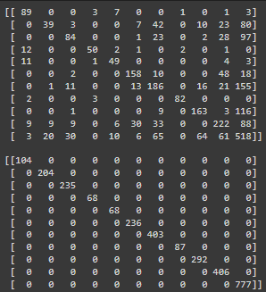
Select and Train a Model
The best are XGB and the last classifier
Getting similar f1_score of 0.569 at local machine
confusion_matrix

Slide 13
Fine-Tune Your Model
Literally fine tuning all the models to fine the parameters
For example XGB got these

Slide 14
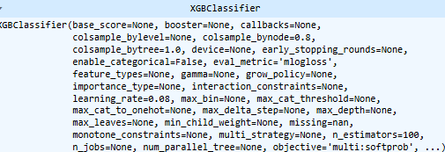
Fine-Tune Your Model
Literally fine tuning all the models to fine the parameters
For example XGB got these
param_grid = {
'n_estimators': [150, 100],
'learning_rate': [0.05, 0.08, 0.1],
'subsample': [0.8, 0.9, 1.0],
'colsample_bytree': [0.8, 0.9, 1.0],
'colsample_bynode': [0.8, 0.9, 1.0],
}

Slide 15
Analyzing error
Not done to be honest

